Slide 1
INFORMATION AND COMMUNICATION TECHNOLOGIES (ICT)
A Comparative Analysis of Google Services, Microsoft Tools, Git, and GitHub

Slide 2
Plan :
Introduction
Google Services
Microsoft Tools
GitHub and Git
Conclusion

Slide 3

Introduction :
Information and communication technologies,(ICTs) is a broader term for Information Technology (IT), which refers to all communication technologies, including the internet, wireless networks, cell phones, computers, software, middleware, video-conferencing, social networking, and other media applications and services enabling users to access, retrieve, store, transmit, and manipulate information in a digital form.

Slide 4
2. Google services :
2.1. Google Search :
Google Search is a powerful search engine that enables users to find information from across the web quickly and efficiently. With its advanced algorithms and vast index, it has become the go-to tool for information retrieval.
2.2 Google Drive :
Google Drive is a cloud storage and file synchronization service that allows users to store, access, and collaborate on files and documents. Its seamless integration with other Google services makes it a popular choice for individuals and teams.

Slide 5
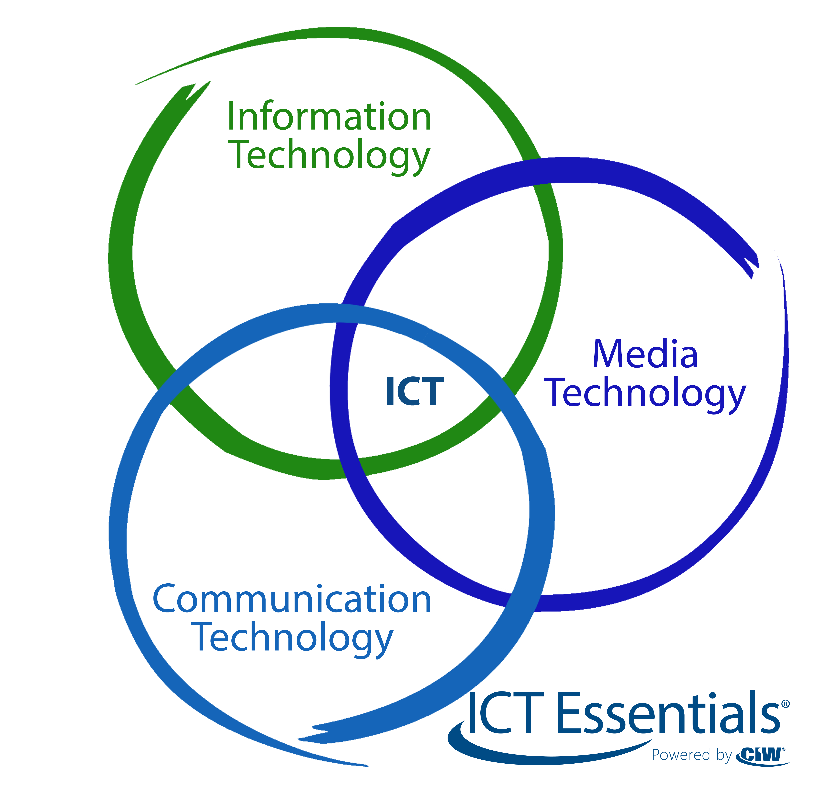
2.3. Google docs :
Google Docs is a web-based word processing tool that enables real-time collaboration and document sharing. Its intuitive interface and features like commenting and revision history make it a valuable tool for collaborative writing and editing.

Slide 6
3. Microsoft tools :
3.1. Microsoft Office Suite:
Microsoft Office Suite, including Word, Excel, and PowerPoint, has long been the industry standard for productivity tools. Its comprehensive features and familiarity make it widely used in various professional settings.
3.2. Microsoft Teams:
Microsoft Teams is a collaboration platform that combines chat, video meetings, file storage, and app integration. It facilitates seamless communication and collaboration among team members, especially in remote work environments.

Slide 7
3.3.tools:
Tool | Description
Microsoft Word | Word processing software for creating and editing documents.
Microsoft Excel | Spreadsheet software for organizing and analyzing data.
Microsoft PowerPoint | Presentation software for creating visually engaging slideshows.
Microsoft Teams | Collaboration platform for chat,video and meeting,and file sharing.

Slide 8
4.Git and GitHub: 4.1.Git: Git is a distributed version control system that allows devrlopers to track changes and collaborate on software development projects Its decentralized nature and branching capabilities make it an essential tool for version control

Slide 9



GitHub is a web-based hosting service for Git repositories . Its provides a platform for devlopers to collaborate, share code, and manage software projects . GitHub’s features,such as pull requests and issue tracking, enhance the collaborative development .
4.2.GitHub

Slide 10




Category | Google | Microsoft | Git | GitHub
Collaboratoin Tools | Google Docs, Drive | Microsoft Office 365 | Git Command line | GitHub Pull Requests
Data Storage | 15 GB (Google Drive) | 1 TB (OneDrive) | N/A | Unlimited (GitHub)
Integration Capabilities | Google Workspace | Microsoft 365 | Thiard- Party services | Thiard- Party services
User Interface | Intuitive And clean | Familiar And modern | Command Line interface | Web based interface

